Slide 1


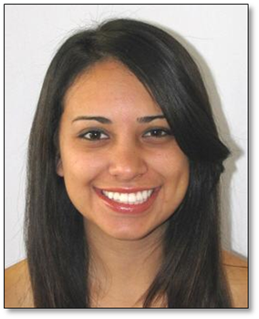
<FANCY SOFT DRINK name>
<1st ingredient>
<2nd ingredient>
<3rd ingredient>
<BARTENDER´S CHOICE DRINK name>
<1st ingredient>
<2nd ingredient>
<3rd ingredient>
Name:
School:

